Slide 1

Artificial Intelligence and Neural Network

Slide 2
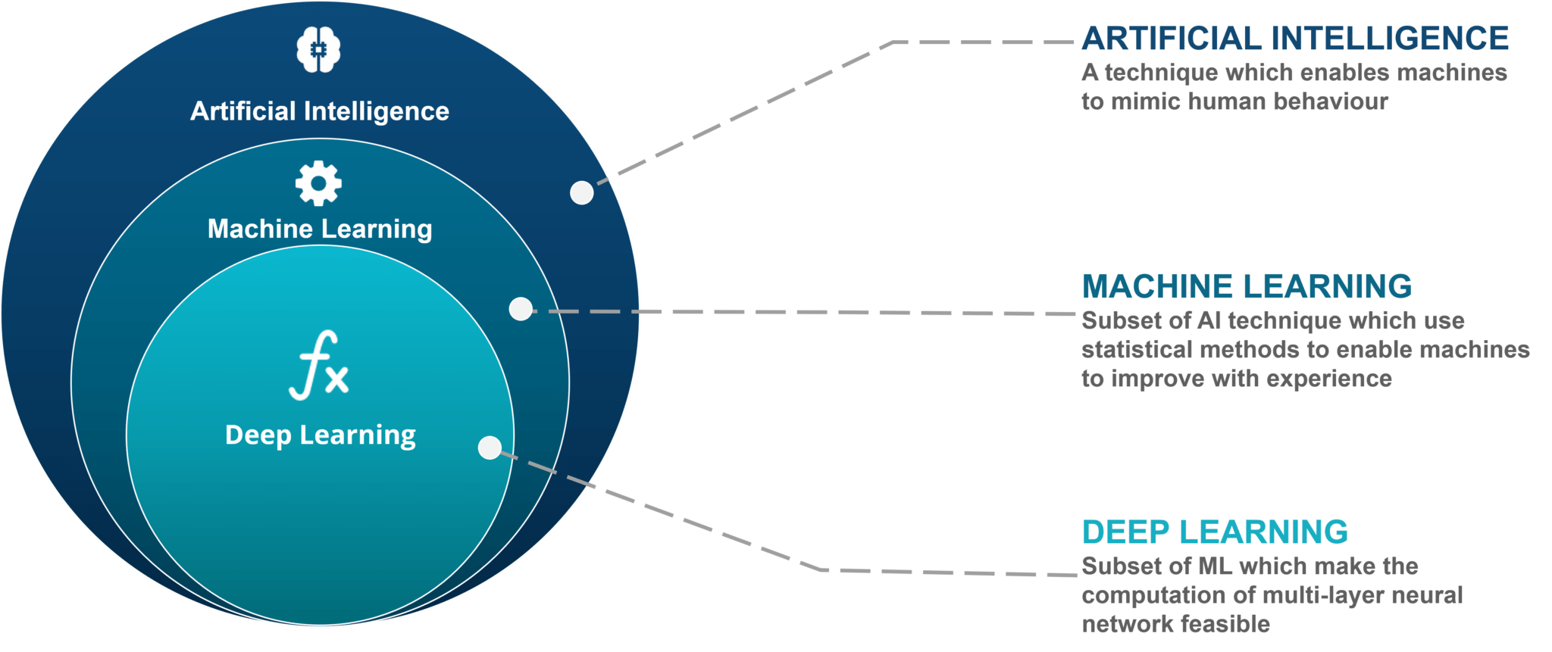
AI vs ML vs DL

Slide 3





Deep Learning Frameworks

Slide 4
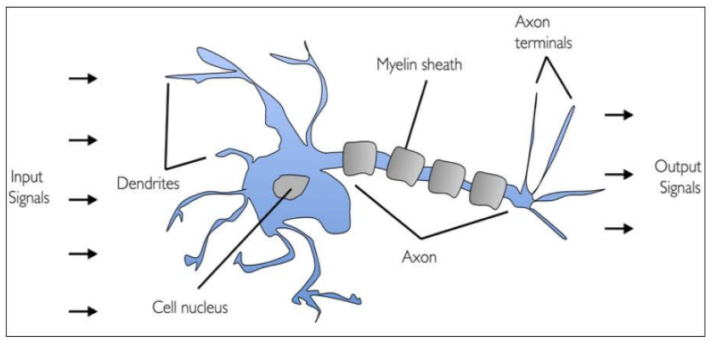
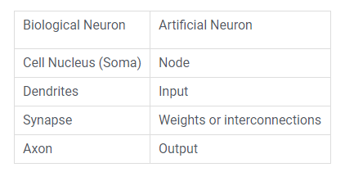
Biological Neuron

Slide 5
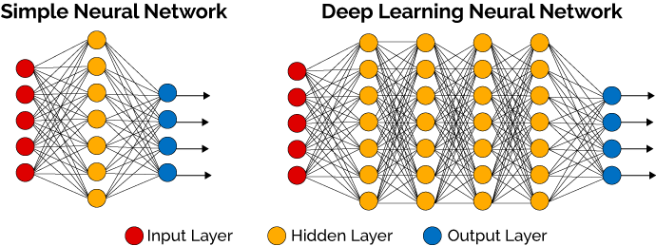

Slide 6

Artificial Neural Network
Feedforward Network
Backpropogation
Head of Google Brain

Slide 7
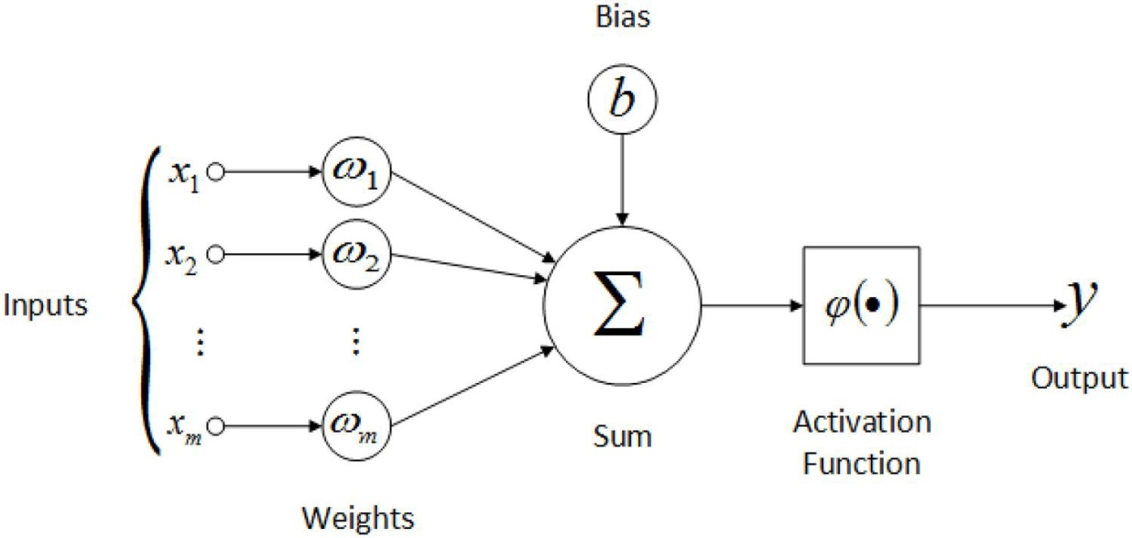
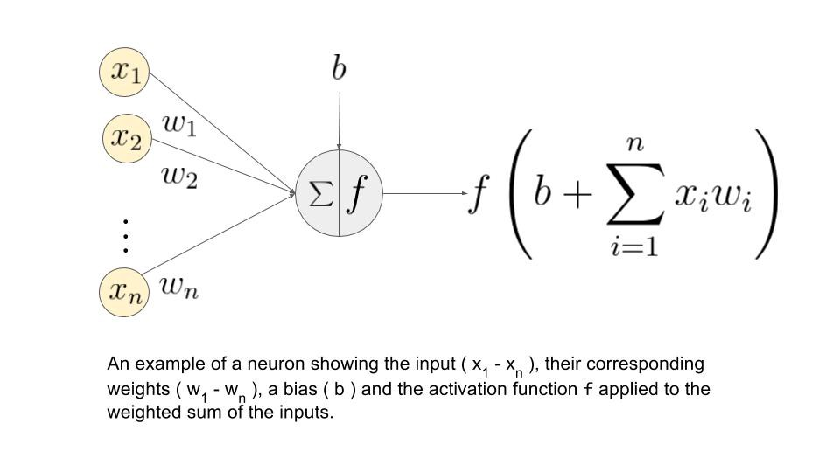
Artificial Neuron - Perceptron
Inputs
Weights
Bias
Activation Function
Output
Matrix Multiplication between
Input values and Weights
Weights and Biases are trainable parameters

Slide 8

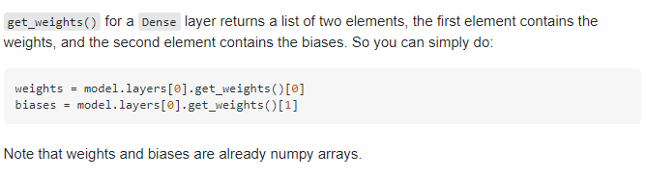
Why we need bias in Neural Network?
The bias unit guarantees that even when all the
inputs are zeros there will still be an activation in the neuron.

Slide 9
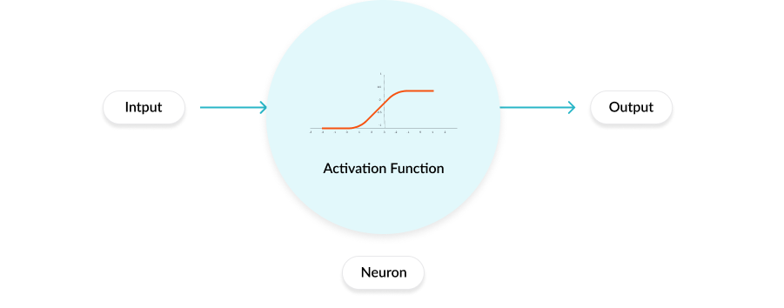
Activation Function
In neural networks, activation functions determine the output of a node from a given set of inputs
Some commonly used Activation Functions
Sigmoid – Output Layer (Binary)
Softmax(Multi Class)
Relu – Hidden Layer
Leaky ReLu
Tanh
Linear
https://dashee87.github.io/deep%20learning/visualising-activation-functions-in-neural-networks/

Slide 10

Please contact
Foundation for Innovation and Collaborative
Education
mentor@fice.in
www.fice.in
Please contact
Foundation for Innovation and Collaborative
Education
info@fice.in
mentor@fice.in
Notes:
Here are the lessons we are going to learn today.

